Slide 1
M-99 Traffic Calming Plan
4 to 3 lane conversion
Road Diet 2027

Slide 2
Background
2008 MDOT completed the current reconstruction of M-99.
2013 TIFA conducted a place making study. It was recommended to implement a traffic calming plan (road diet) to M-99
2020 City and mdot staff met to discuss preliminary requirements of a traffic calming of m-99. The same afternoon that the meeting was held, the Governor ordered a lockdown of the State due to the growing pandemic from Covid.
2023 Mdot contacts city to explore interest in implementing traffic calming during 2027 m-99 resurfacing project.
2024 Submitted application for a transportation alternative program (tap) grant to help offset costs.
2027 Scheduled project to begin. Any delays due to the “road diet” design delays or tap grant could change project start to 2028

Slide 3
Motivation
Calmer traffic flow
Pedestrian safety
Noise reduction
Economic development

Slide 5
Intersection Safety
All left turns cross only one lane
Wider turning radius for right turns
Buffer zones along parking areas
Reduction in sideswipe and rear end crashes

Slide 6
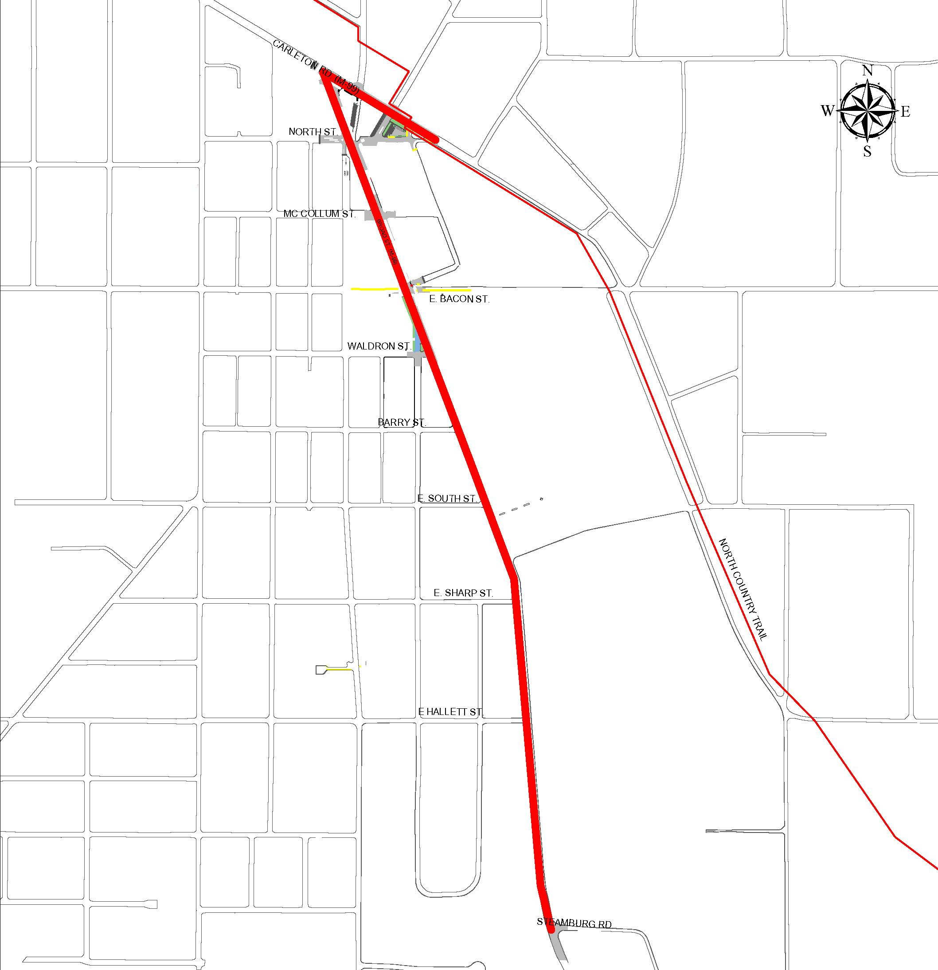
Project Goals
Make pedestrian crossings safer
Add signage and new crosswalks
Make biking safer
Add bike lanes along Broad st.
Make it safer for drivers
Reduce risk of injury in a crash
Add designated left turn lane
Slow traffic through downtown

Slide 7
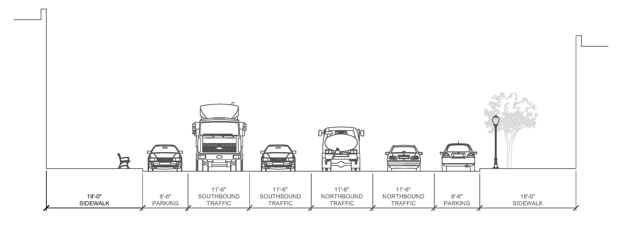
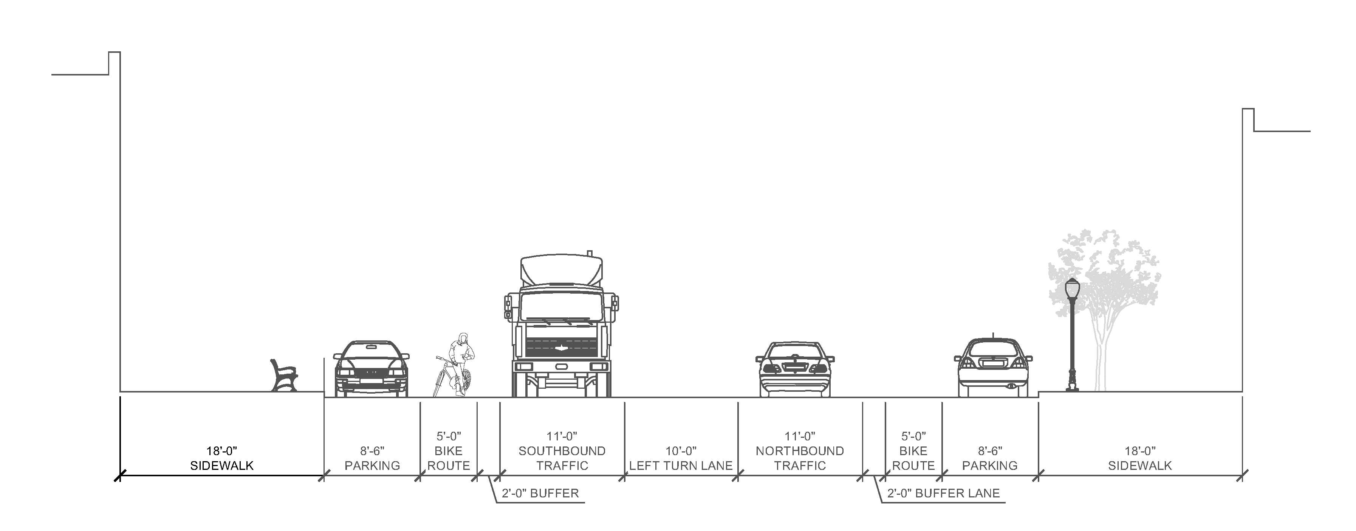
Existing Street Conditions
Proposed Street Conditions

Slide 8
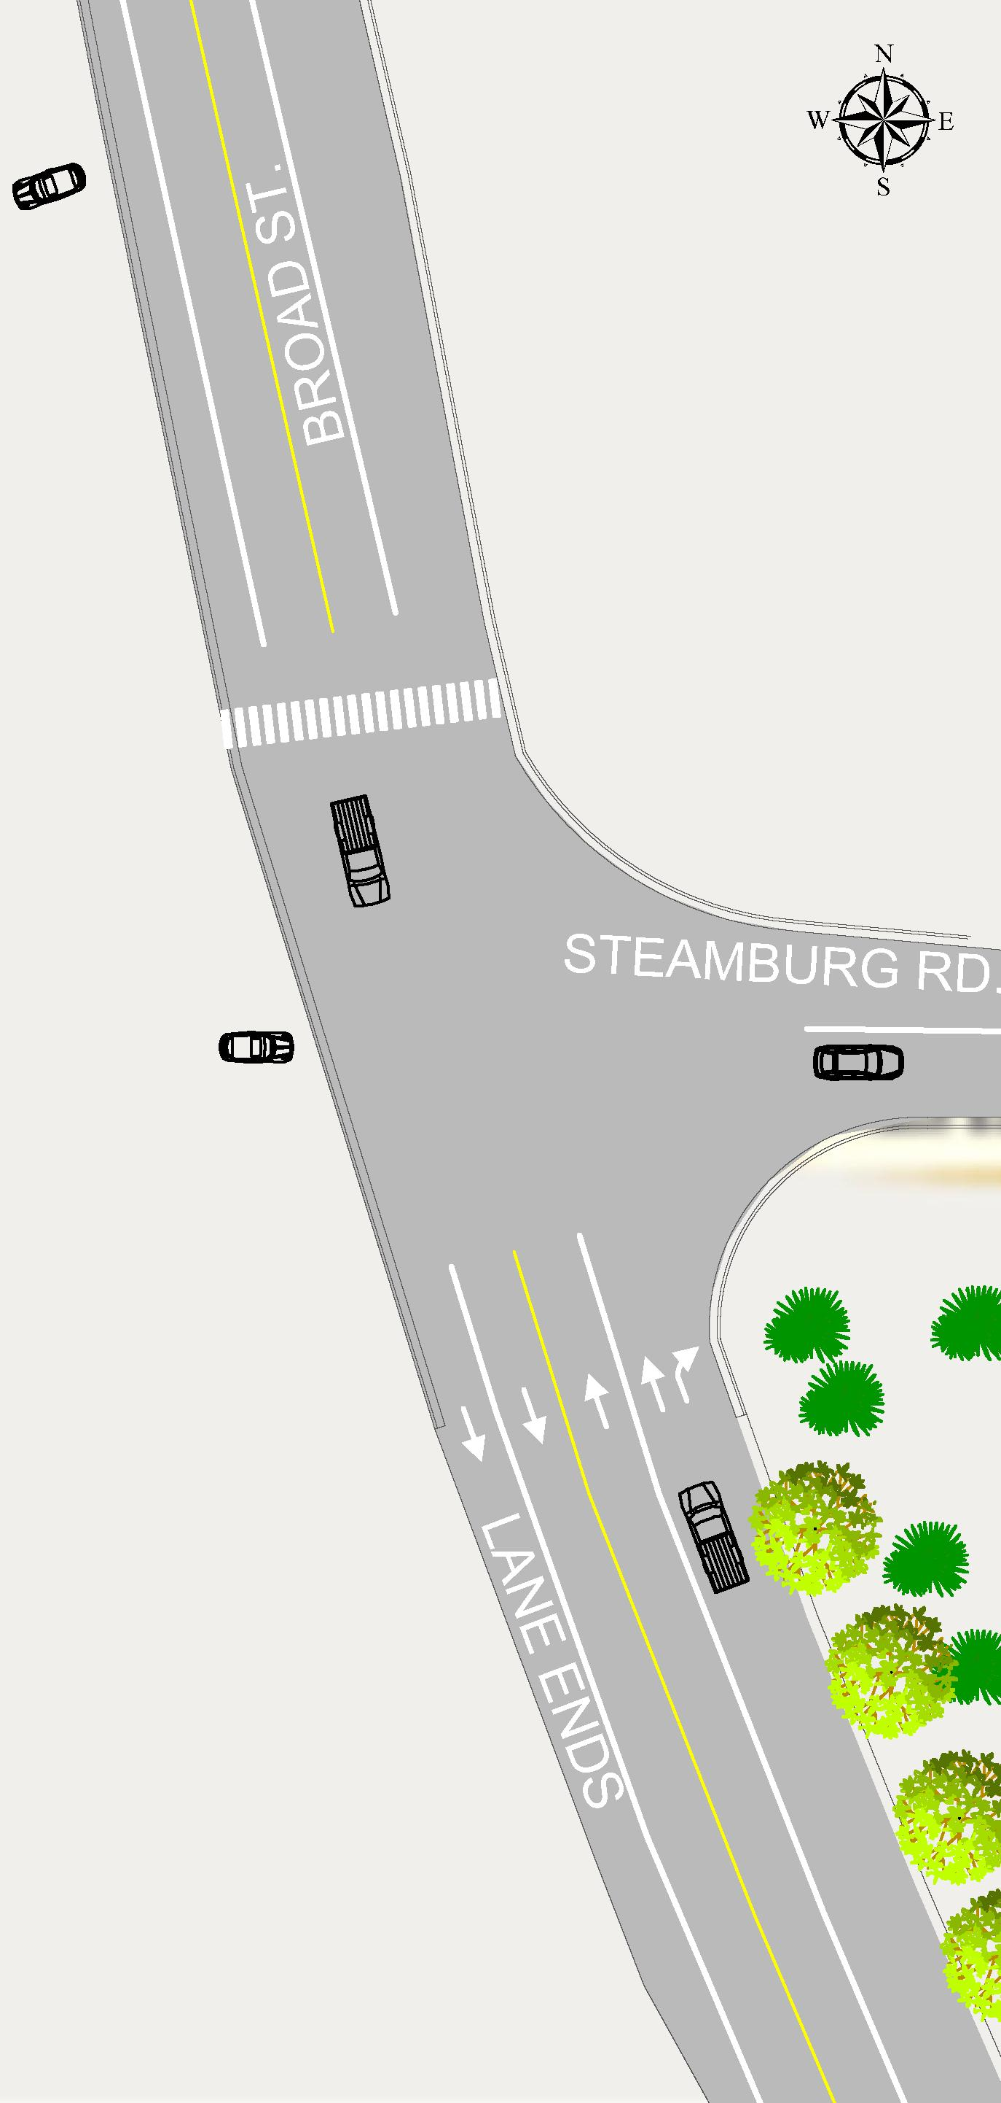
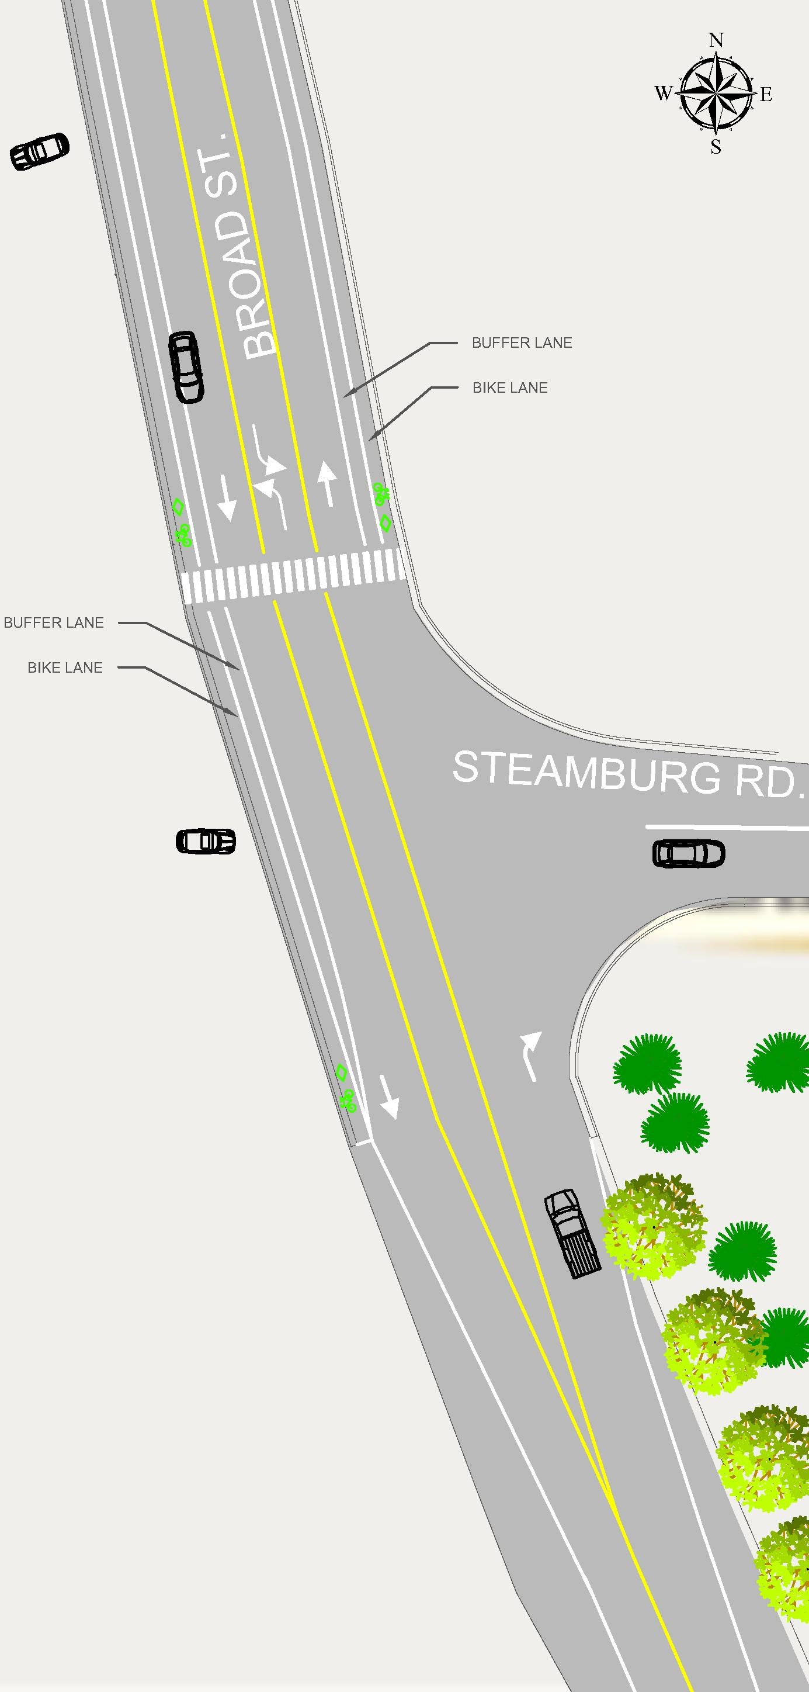
Project Plans – Steamburg at S. Broad
Existing conditions
proposed conditions

Slide 9
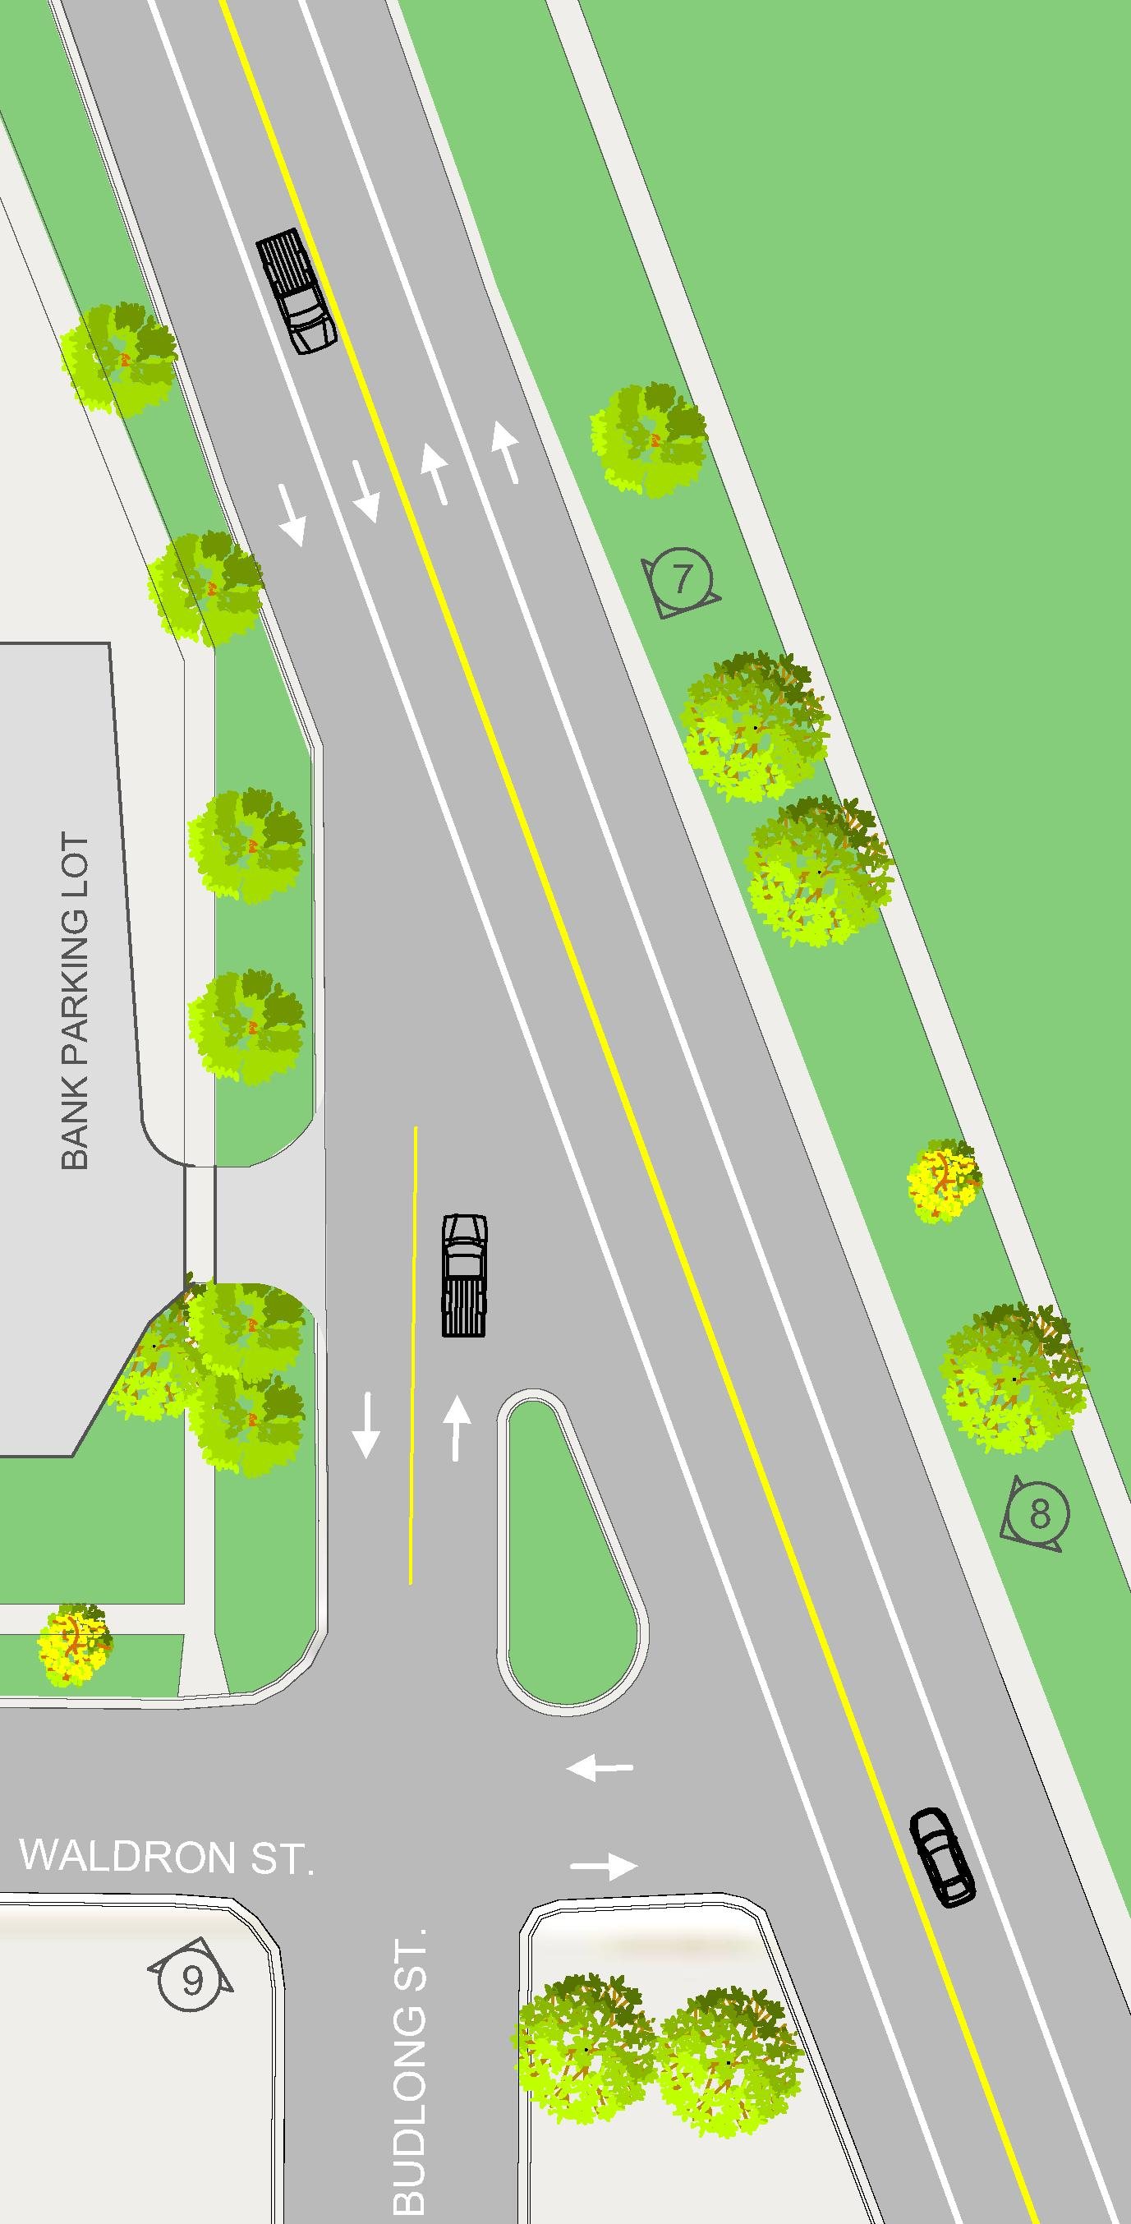
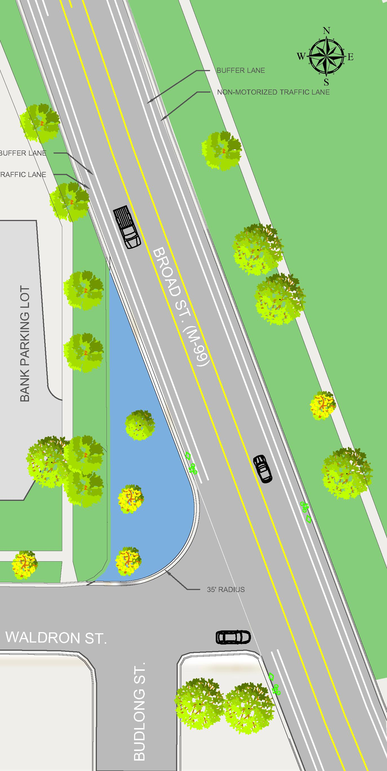
Project Plans – Waldron at S. Broad
Existing conditions
proposed conditions

Slide 10
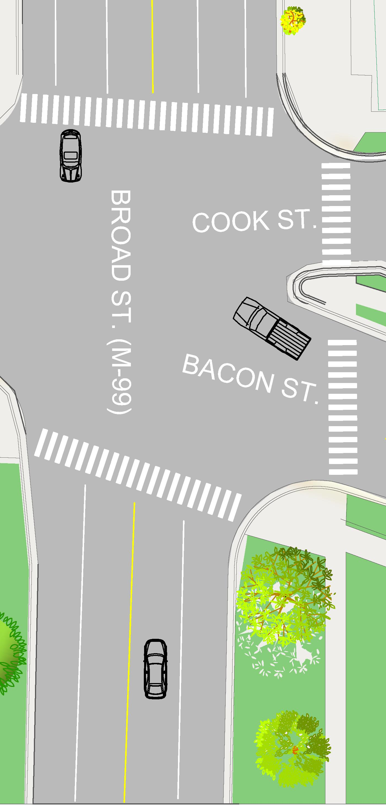
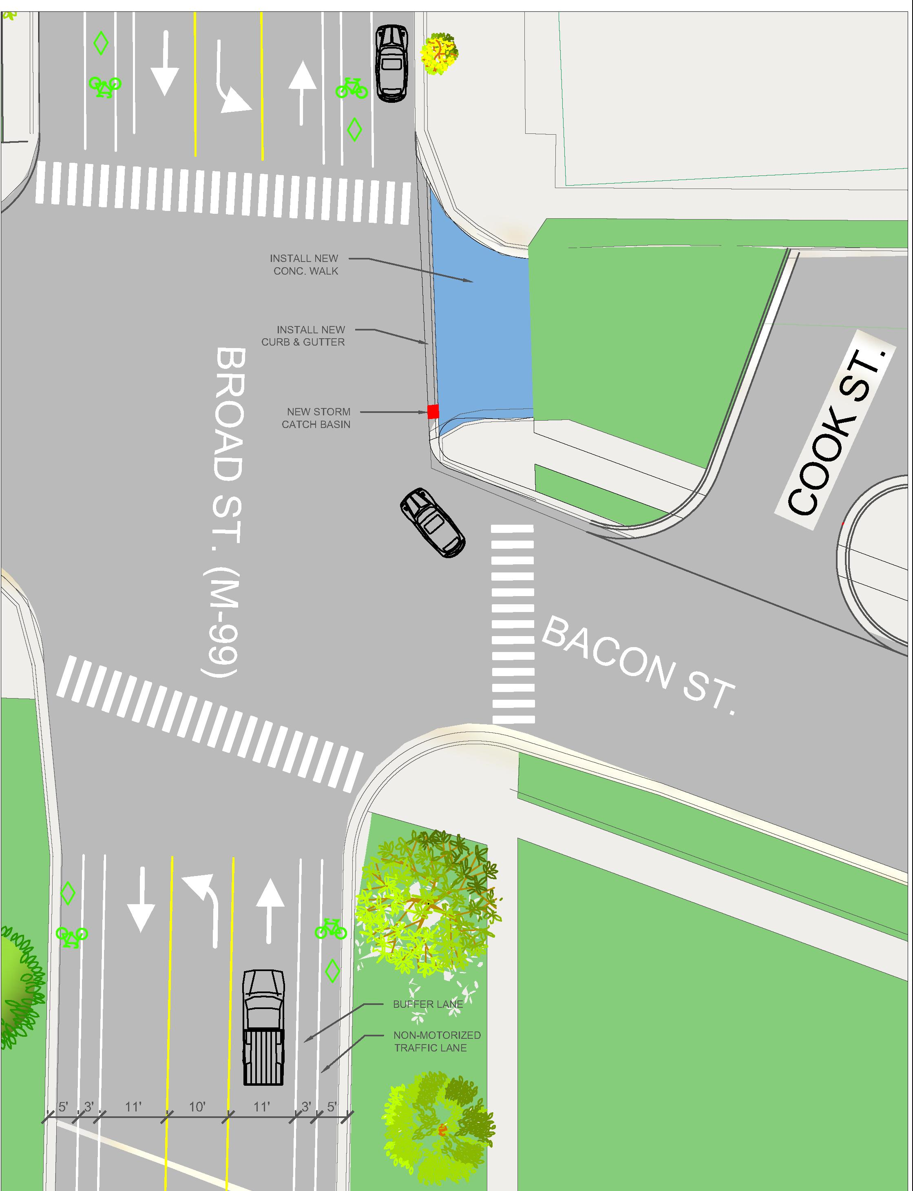
Project Plans – Bacon at S. Broad
Existing conditions
proposed conditions

Slide 11
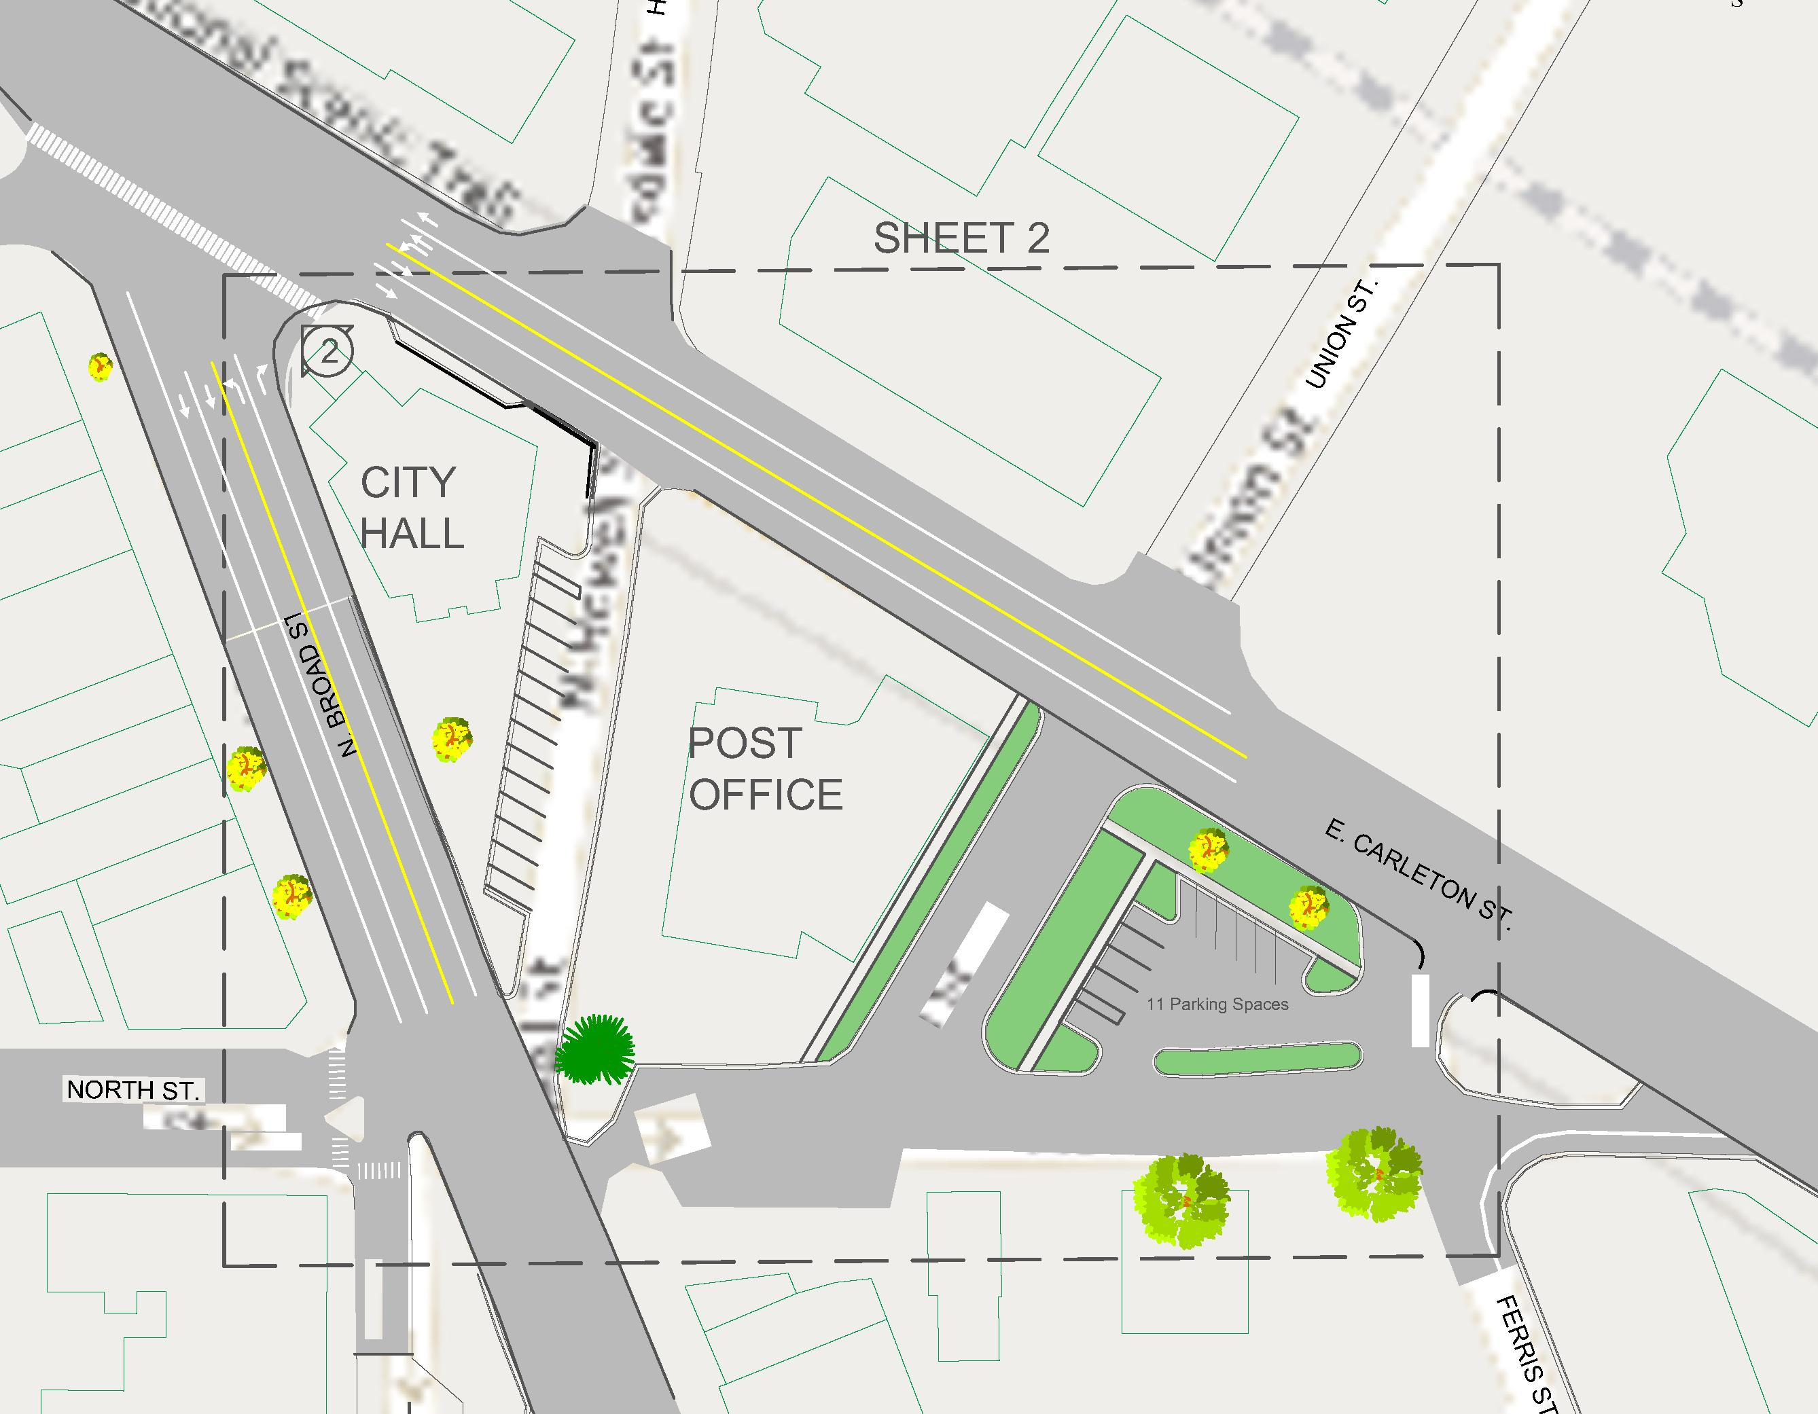
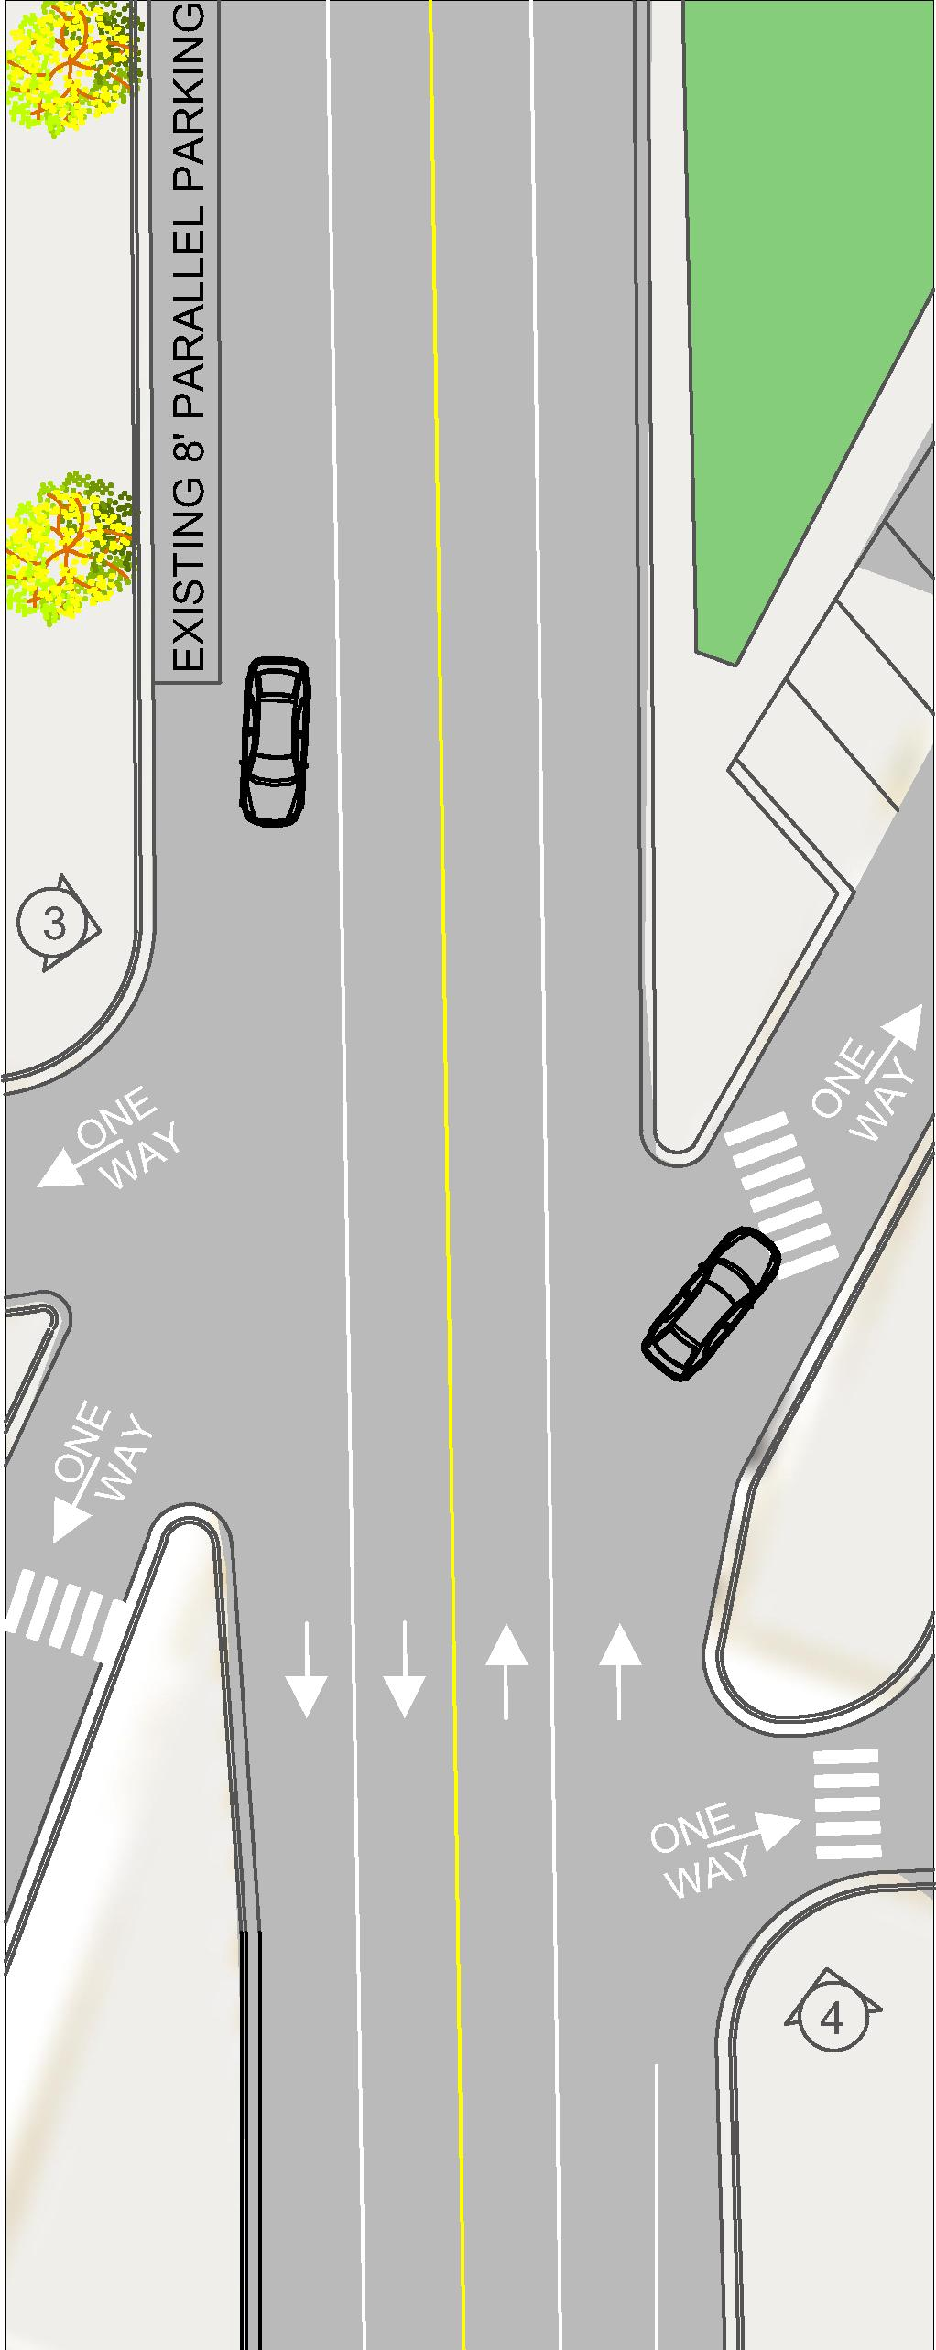
Project Plans – Carleton at S. Broad – Existing

Slide 12
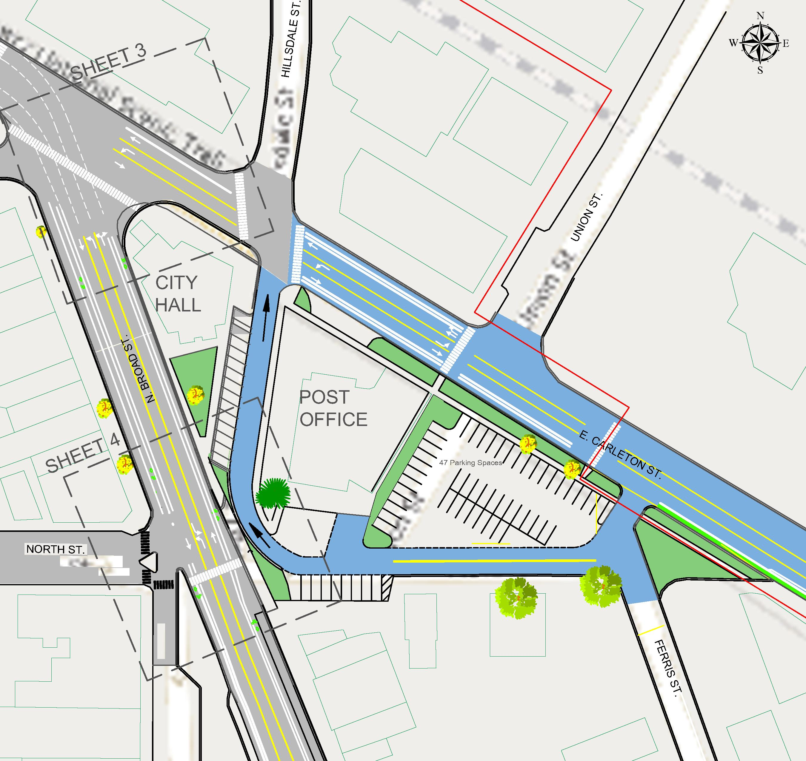
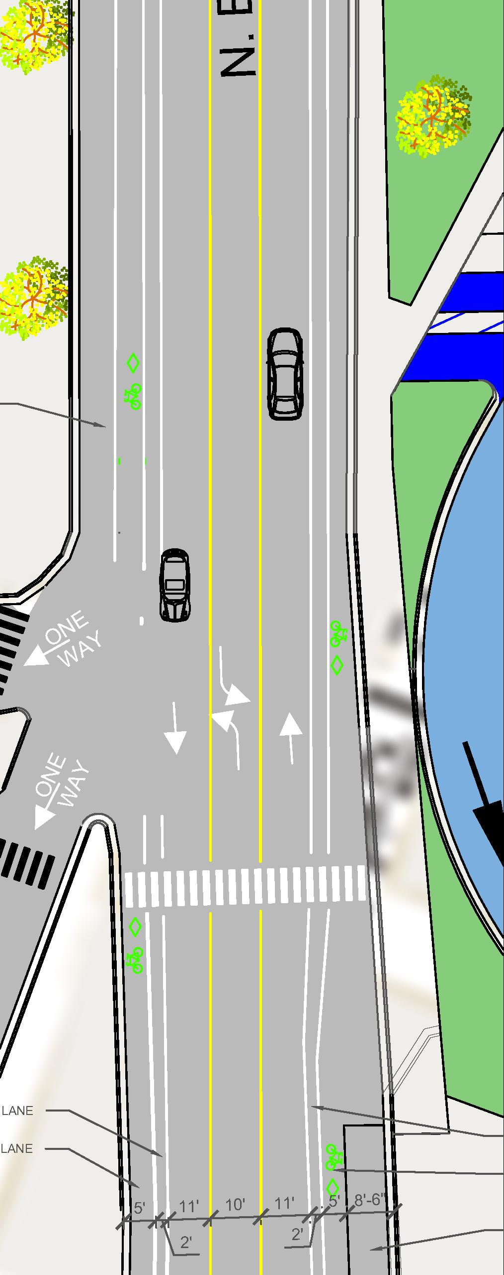
Project Plans – Carleton at S. Broad - Proposed

Slide 13
4 to 3 LANE CONVERSIONS
IMPROVES BIKE AND PEDESTRIAN SAFETY
BIKE LANES ARE MORE CONVENIENT THAN SIDEWALKS
BIKE LANES provide safe separation between pedestrians and bicyclists.
SAFER PEDESTRIAN CROSSING DUE TO REDUCED NUMBER OF LANES
opportunity FOR PEDESTRIAN REFUGE ISLANDS

Slide 14
APPROPRIATE LANE WIDTH?
12’ – MOVING TRAFFIC / TRUCKS
11’ – TRAFFIC CALMING EFFECT (ROAD DIET)
10’ – USED IN CITIES AND NEIGHBORHOODS

Slide 15
QUESTIONS and ANSWERS
We will collect your question cards at this time.

